Slide 1
Kidney disease is the 8th leading cause of death in the US, followed by liver disease.
*The CDC, 2023
PROBLEM
https://www.cdc.gov/nchs/fastats/leading-causes-of-death.htm
Notes:
Omg do you guys hear that? It sounds like there’s a KILLER of women among us.
While often attributed to other factors, a major, hidden contributor to chronic organ injury is the unmonitored, long-term, high-dosage use of NSAIDs to manage debilitating menstrual cramps.

Slide 2
The Solution: CycleSIGHT
Because pain isn’t one-size-fits-all.
Price per product: $200
Notes:
To stop this cycle of damage, we created CycleSIGHT. We aren't just selling a test; we are offering a personalized treatment roadmap for $200.
Our CLIA-certified laboratory developed test analyzes specific genetic markers related to drug metabolism, pain sensitivity, and endometriosis risk.
This empowers clinicians to stop guessing and start treating. Why is this important? Because pain isn’t one-size-fits-all — but treatment often is.
WHEN underlying pain biology isn’t considered, patients may depend on repeated NSAID use, increasing their risk of kidney and liver disease. We provide a precision pain profile that helps prevent that avoidable harm.

Slide 3

JACKIE
Notes:
This is Jackie. Her menstrual cycle started this morning, and with it came some painful menstrual cramps. Thankfully, she is able to alleviate her cramps by taking 1 ibuprofen every 6 hours as needed for the first day of her cycle. Then she is all smiles and good to go!
15s

Slide 4

MAYA
Notes:
This is Maya. Just like Jackie, Maya’s menstrual cycle began this morning and brought along some bad menstrual cramps.
Unlike Jackie, 1 ibuprofen does nothing for Maya. Maya has to take 4 capsules every 6 hours to feel pain relief, and she experiences cramps up until the 4th day of her cycle–so she has to adhere to that strict medication regimen for 4 consecutive days.
26s

Slide 5
JACKIE’S LIFETIME IBUPROFEN CONSUMPTION
1,680
Notes:
When you break down the math accounting for jackie’s medication needs, over the course of her life she will have taken 1,680 ibuprofen pills due to menstrual pain. Not that bad, right?
10s

Slide 6
MAYA’S LIFETIME IBUPROFEN CONSUMPTION
26,880
Notes:
When you break down the math accounting for maya’s medication needs, she will end up taking over 26k ibuprofen for menstrual pain within her lifetime.
If Maya carries genetic variants that impair NSAID metabolism, this level of use could put her at significant risk without her even realizing it—highlighting the need for early, personalized insight.
Its because of discrepancies in treatment needs such as these between jackie and maya, that CycleSIGHT is so important.
26

Slide 7
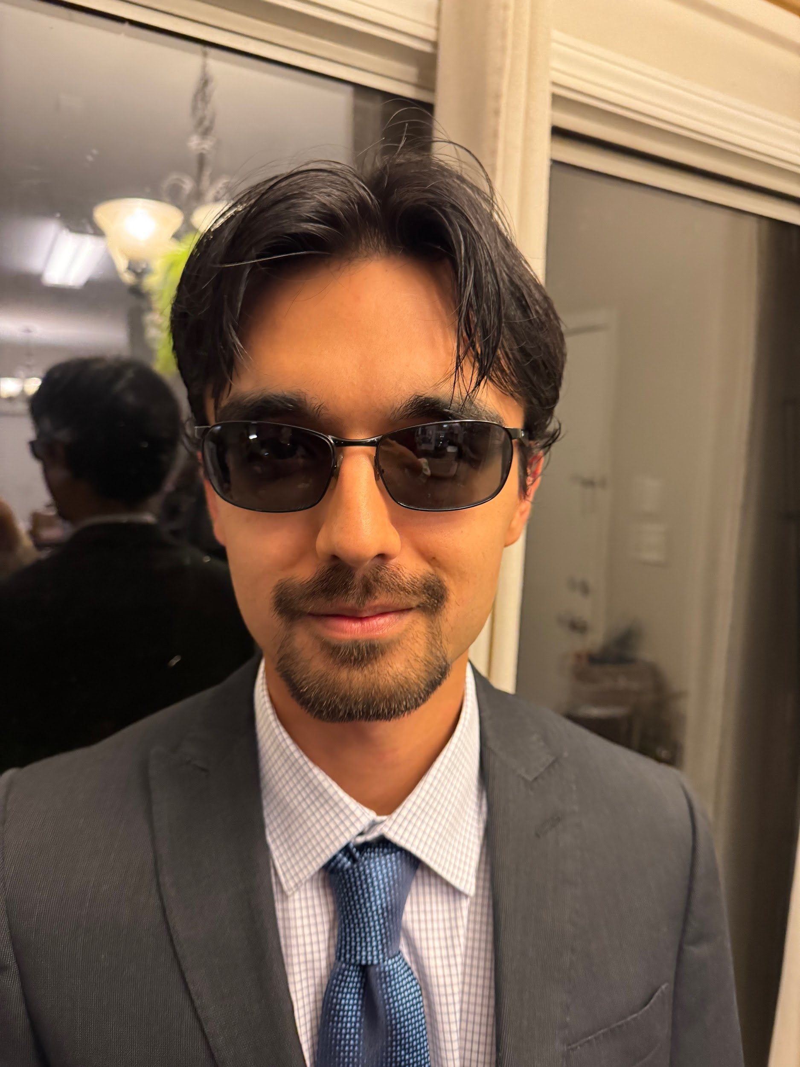
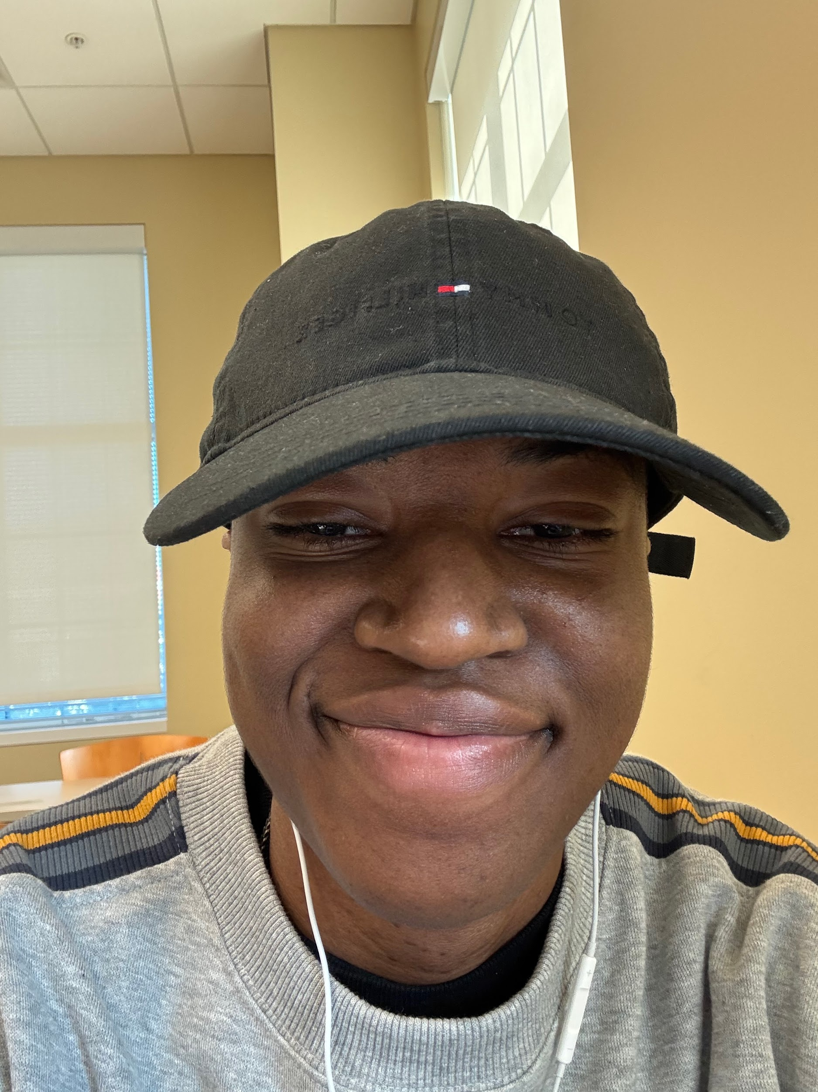
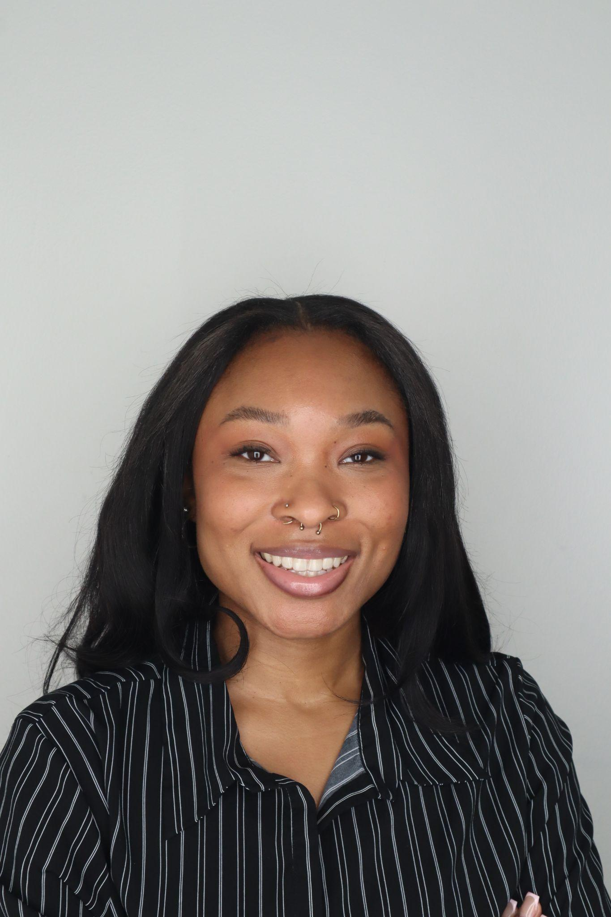
Meet the team
Farruh Turgunov
Glo Jackson
CFO
CEO
Directs financial strategy, market analysis, and venture positioning to ensure long-term sustainability
Drives the development of personalized diagnostic tools by bridging clinical workflow insights with advanced genomic research
Aiyana Sharpe
CTO
Bridges genomic rigor with clinical workflow, leading technical development and assay design for a scalable, provider-friendly platform
Notes:
And we are happy to help. Why is our team special? Because we are passionate individuals combining clinical and bioinformatic expertise.
Maybe i go first, then farruh, then yana

Slide 8
The CycleSIGHT Journey
Patient Consultation
Test Ordered
Collect Sample
Molecular Analysis
Personalized Care
Notes:
Should take 30 seconds to go through –28s
Patient comes to clinic or PCP with menstrual pain symptoms
Clinician orders CycleSIGHT test
Patient provides a saliva sample
The patient's saliva sample is analyzed at our CLIA-certified lab using qPCR TaqMan assay technology & a report is generated and sent to the clinician
Clinician uses the report to guide treatment

Slide 9
SNPs of Interest
Pain Sensitivity
SNP rs4680 in the COMT gene
SNP rs20417 in the PTGS2 (COX-2) gene
Possible Clinical Interpretation from CycleSIGHT Report
"NSAID Metabolism Issue." Patient is a slow/poor metabolizer. High risk of toxicity with standard NSAID doses.
Drug Metabolism
SNPs rs1799853 & rs1057910 in the CYP2C9 gene
Endometriosis Risk
SNP rs17562 in the ILA1 gene
SNP rs7521902 in the WNT4 gene
Notes:
These are the single nucleotide polymorphisms or SNPs the CycleSIGHT test looks for. SNPs are basically mutations that can be good, neutral, or bad; but these are bad.
Our test covers SNPs associated with pain sensitivity, drug metabolism, and endometriosis risk.
The resulting report states what SNPs the patient has along with its associations, so the clinician can make an interpretation, such as “this patient cannot break down NSAIDs, so we should use low or no dosage”

Slide 10
IP
We have a provisional patent on the diagnostic method as we are currently refining and producing our in house built unit to do the diagnosis. Additionally, we have a number of trade secrets we protect.

Slide 11
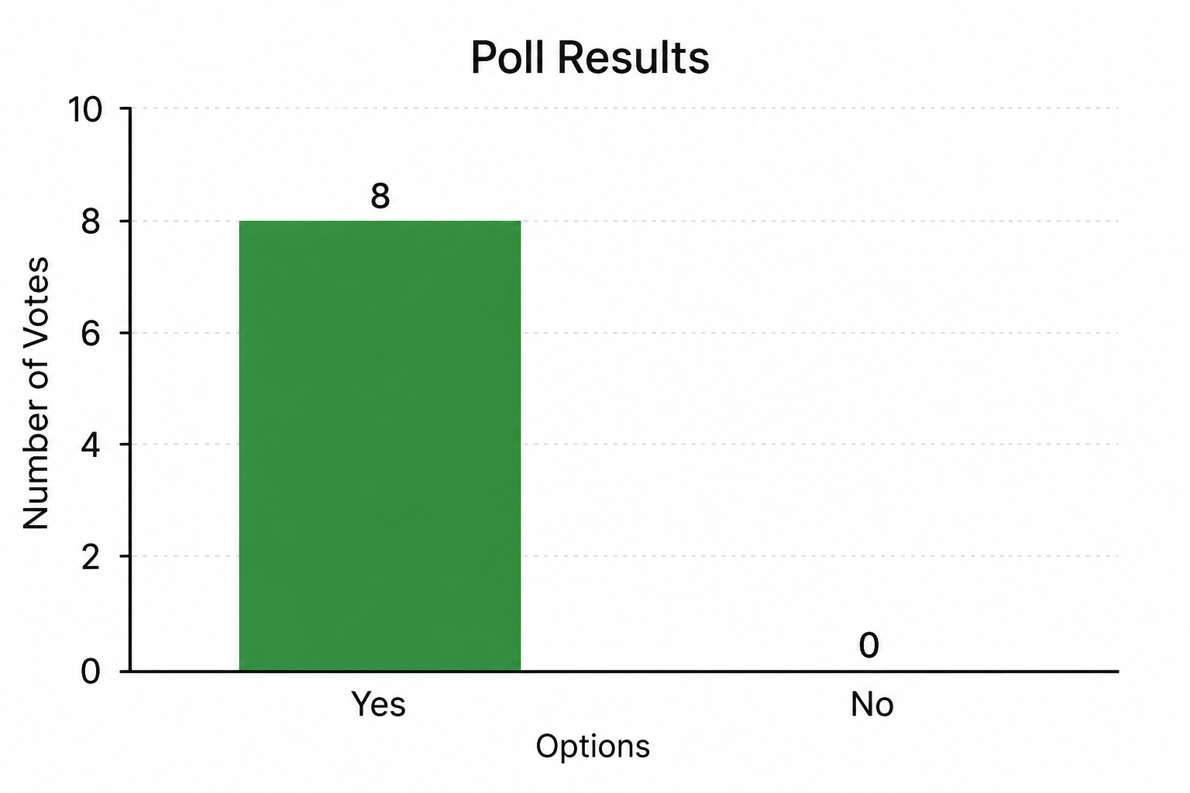
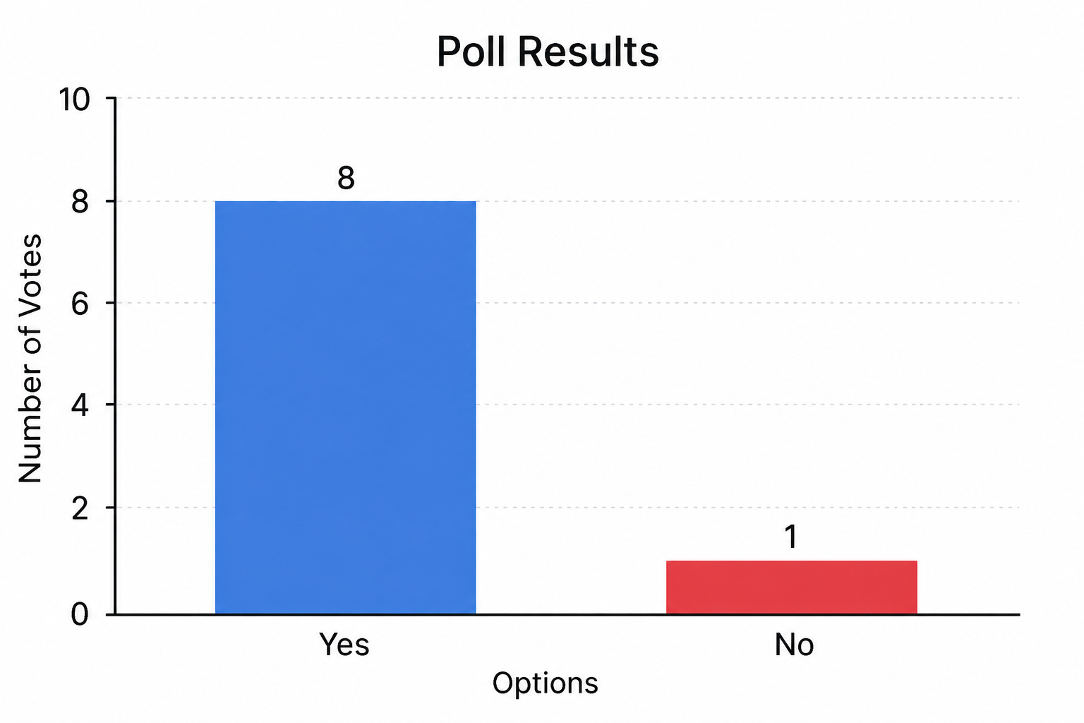
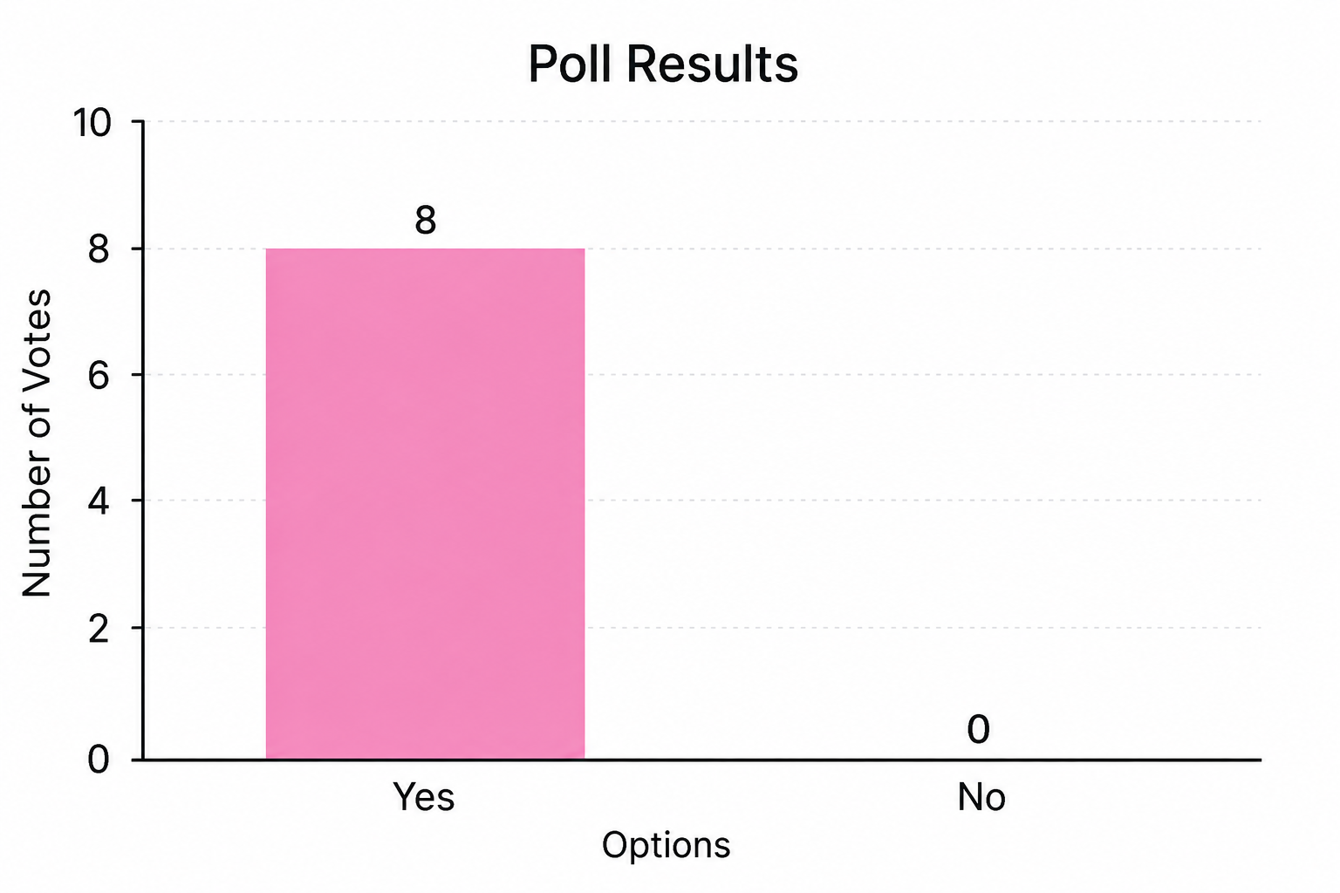
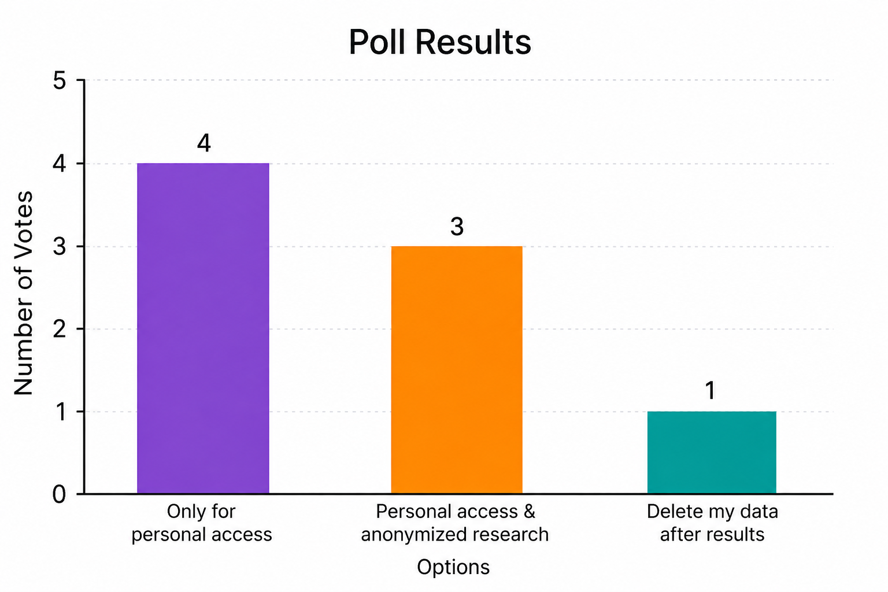
Would people spend money on our product?
Is there a gap in the market?
Concerned about long term effects of NSAID use?
Are you concerned about cost?
How do you want your data handled?
Notes:
during our customer discovery, we found that people are most concerned with the current solutions to managing menstrual symptoms, the effects of nsaid overuse, and cost. for the questions we asked regarding these topics, the majority OR everyone said yes. another top priority of our target market is data privacy. we found that people would either want their data kept only for their personal access and/or anonymized for research, or have their data deleted after they’ve received their results.

Slide 12
What are the estimates?
TAM
TAM:
All Menstruating Individuals ~$492 Billion
SAM
USA ~$21 Billion
SOM
Assuming we can service 257k women per year (0.25%): ~$51m per year.
SAM
SOM
Notes:
There are approximately 2.46 billion potential customers worldwide, based on the assumption that roughly 60% of the global female population falls between the ages of 12 and 55. This represents our Total Addressable Market (TAM), equivalent to about $492 billion at our current test price.
Focusing on the United States, our Serviceable Available Market (SAM) is approximately $21 billion.
Even with a highly conservative estimate, if we were to serve just 0.25% of females in the U.S. within our target age range, this would translate to approximately 257,000 customers annually. At our current pricing, that represents roughly $51 million in annual revenue.

Slide 13
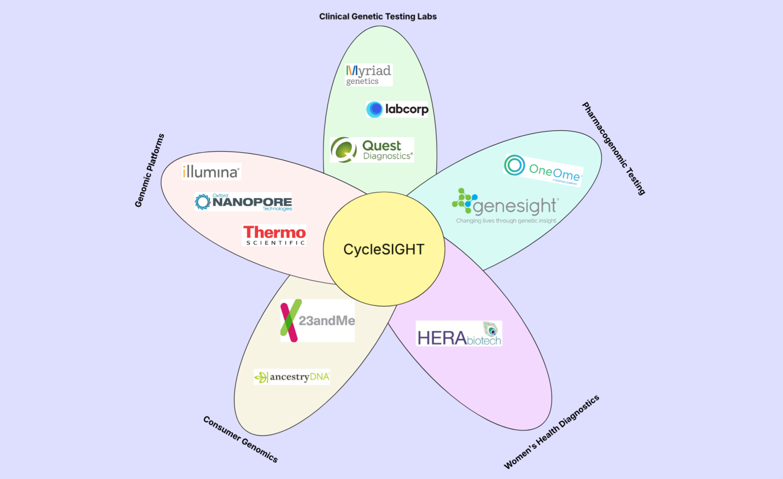
Notes:
MENTION THESE R OUR COMPETITORS
CycleSIGHT is a blend of the markets that includes Clinical Genetic Testing Labs, Pharmacogenomic Testing, Women’s Health Diagnostics, Consumer Genomics, and Genomic Platforms.
To get a better understanding of what we do, let us zoom in on one of the petals, specifically the Clinical Genetic Testing Labs.
Myriad genetics offers testing to determine cancer risk, mental health, and reproductive health.
They, for example, offer a test that analyzes for mutations in BRCA1 that are associated with hereditary breast and ovarian cancer syndrome.
While we, on the other hand, look for markers that tell us how the customer(s) react to pain medications and screen for endometriosis risk.

Slide 14
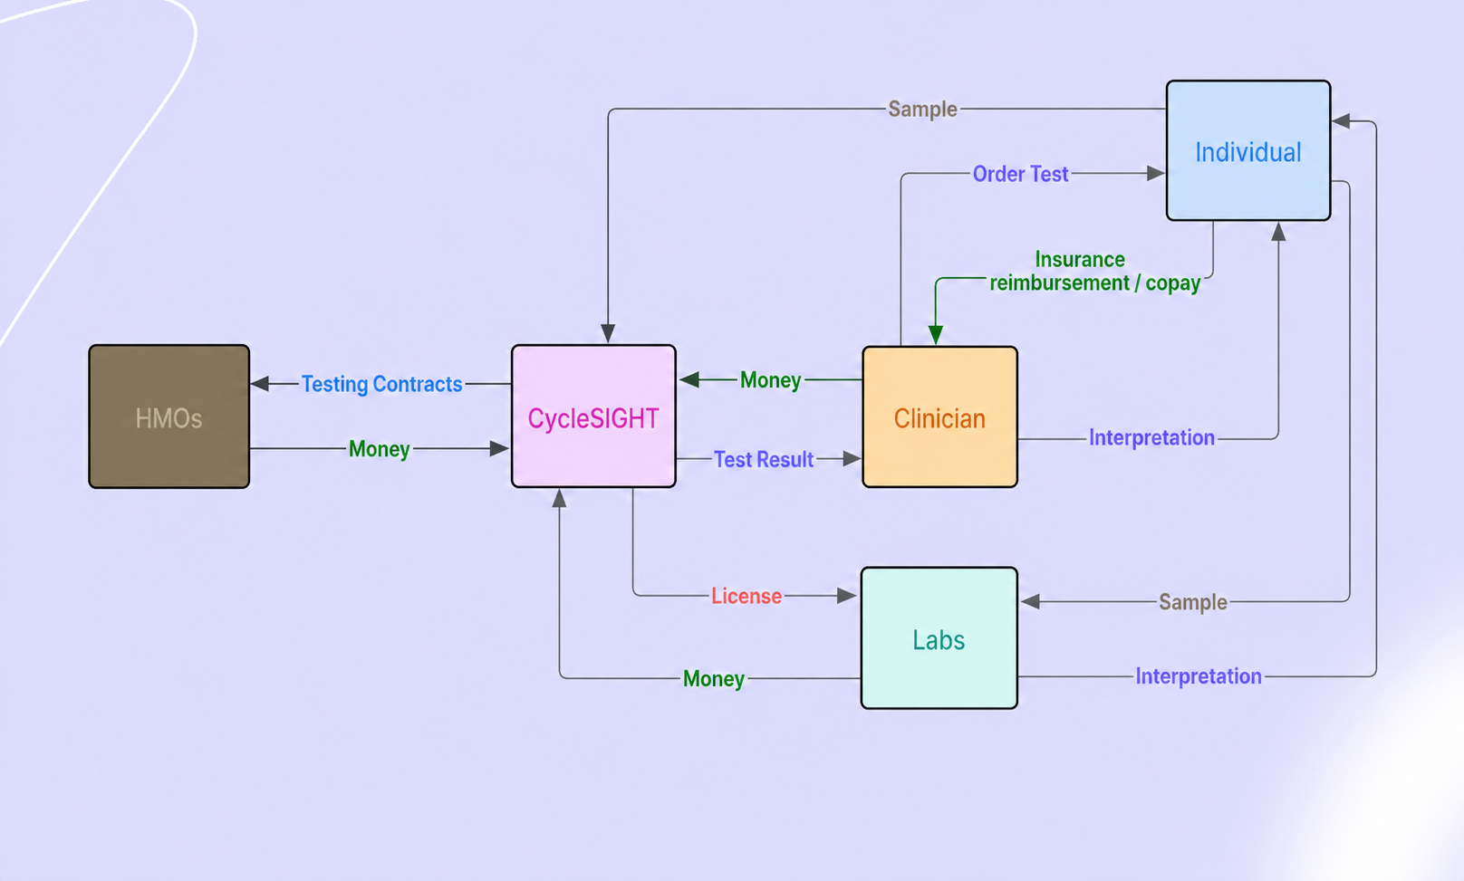
Notes:
This is our ecosystem, which highlights CycleSight’s primary revenue streams: HMOs, clinicians, and licensed laboratories.
Here’s how the process works:
An individual experiencing menstrual pain consults their clinician. From there, two pathways are possible. In the first case, the clinician is already partnered with CycleSight and directly orders our test. In the second case, the patient inquires about CycleSight and requests that their clinician order the test on their behalf.
Once the test is ordered, a swab sample is collected and sent to CycleSight for analysis. After processing, the results are returned to the clinician, who provides a professional interpretation and discusses next steps with the patient.
Currently, our primary source of revenue comes from clinician-ordered tests.
“In addition, as we scale, we anticipate incorporating insurance reimbursement models, where payers cover part or all of the test cost, reducing out-of-pocket expenses for patients while maintaining clinician-directed ordering.”
However, as we scale, we anticipate shifting toward a more asset-light model, where licensing our testing panel and protocols to external laboratories becomes the dominant revenue stream. In this model, partner labs perform the tests independently while paying royalties to CycleSight.
We also partner with HMOs through contractual agreements that guarantee a set volume of tests, which they offer directly to their members.

Slide 15
Timeline
January
February
March
April
May
June
July
Formalize Company Structure
Hiring Employees
Outreach
Finalization Steps
Facility Acquisition
More Hiring
Hire Administrators
Acquire CLIA Cert.
Refinement
Refine Workflow
More Outreach
WE’RE HERE
First 3 Months
The Next 4-8 Months
Next 6-12 Months
R&D Development
Panel Setup
Validation of Test
Get Patent/IP protection
1 Year from now
2 - 5 Years from now
Increase Scale
More partnerships
License Out
New Facilities
Strive for 1% of SAM
Notes:
In the first three months, we will focus on formalizing the company structure, including hiring key personnel and initiating early outreach efforts.
Between months four and eight, we will prioritize R&D—developing the testing panel, validating its performance, and beginning the process of securing patent protection or other forms of intellectual property.
From months six to twelve, we will finalize operational workflows, secure a dedicated facility, expand our team, and obtain CLIA certification.
By the one-year mark, we aim to refine and optimize our workflow for efficiency while increasing outreach and building broader visibility for the company.
Over the next two to five years, our focus will shift to scaling—expanding partnerships with laboratories and clinicians, building infrastructure where needed, and working toward capturing 1% of our SAM.

Slide 16
Ask: $11.9 Million for 15% Stake
Goal: $200M per year within 2-5 years
R&D | $2.0m
Staffing | $3.0m
Regulatory & CLIA | $2.0m
Infrastructure & Lab Space | $1.9m
Marketing, Outreach, and Clinical Partnerships | $2.0m
Operational & Administrative Costs | $1.0m

Slide 17
Thank you!
CycleSIGHT
Because pain isn’t one-size-fits-all.

